Slide 2
U-turn separator
Innovative evaporator and separator vessel for energy efficient applications in industrial refrigeration
Ind Ref, May 2019

Slide 3
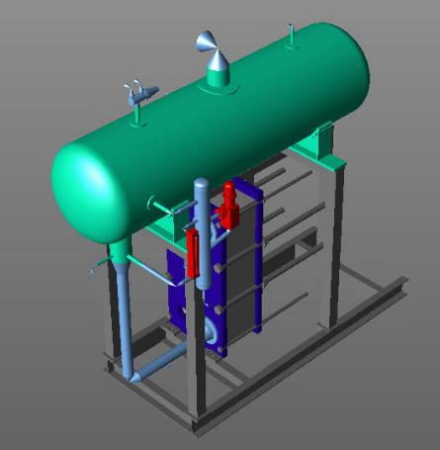
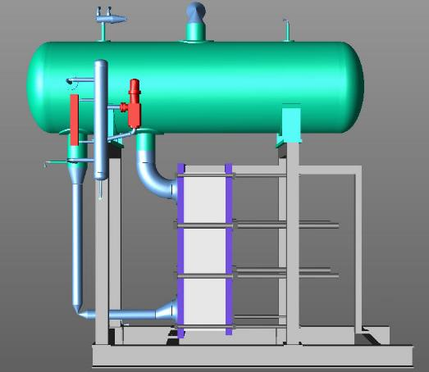
Traditional separator design
Notes:
Traditional gravity separator vessel mounted on a skid with a heat exchanger. Requires welding of piping to the vessel and heat exchanger along with making sure the system pressure drops are optimised properly.

Slide 4
Liquid separator function
To accommodate surplus liquid during load variations
To separate liquid droplets and make sure oil is returned to the compressor
To obtain (close to) saturated gas at suction nozzle
To provide a static head for the circulation
Additionally:
For forced circulation systems; to obtain sufficient liquid column (NPSH_{PUMP}) to avoid pump cavitation
Notes:
Read from the presentation
To accommodate surplus liquid during load variations
To separate liquid droplets and make sure oil is returned to the compressor
To obtain (close to) saturated gas at suction nozzle
To provide a static head for the circulation
Additionally:
For forced circulation systems; to obtain sufficient liquid column (NPSH_{PUMP}) to avoid pump cavitation

Slide 5
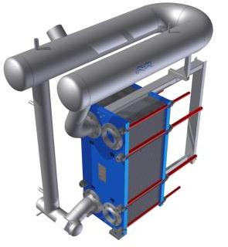
The U-Turn
”energy efficient”
”compact”
”…higher evaporating
temperature”
”high COP”
”Easy to install”
”cost efficient”
”low pressure drop”
”low charge”
Notes:
The main reasons for trying to develop an innovative separator stemmed from the extensive experience by Alfa Laval in troubleshooting thermosyphon ammonia systems in the field and the poor performance of systems they encountered.
The criteria they specified were for the evaporator and separator to be:
Compact
Energy Efficient
Use higher evaporating temperature
Have High COP (Coefficient of performance)
Easy to install
Cost efficient
Low pressure drop
Have a low Ammonia charge

Slide 6
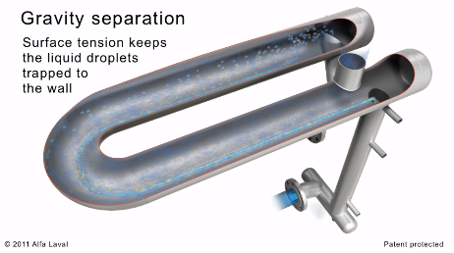
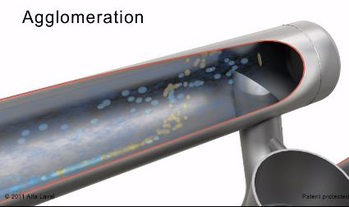
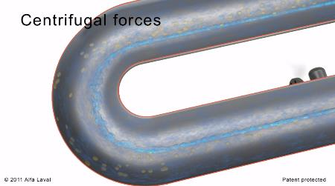
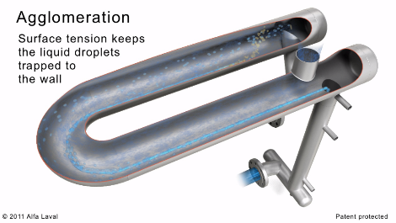
U-Turn Working Principle
Notes:
The movie shows how the U Turn uses agglomeration, gravity separation, Centrifugal forces and surface tension to get the best quality ammonia return possible and only gas goes back to the compressor
Agglomeration
Liquid spray and droplets hit separator wall and agglomerate.
Liquid is held at the separator wall by surface tension.
Gravity separation
Droplets separate by gravity forces along the flow path
Vessel length is 25% more than the length required to separate based on the typical settling velocity of the refrigerant
The velocity inside the vessel is only 60 % of re-entrainment velocity
Separation by centrifugal forces
Droplets collide in the 180° elbow and agglomerate
Liquid is held at the separator wall by surface tension

Slide 7
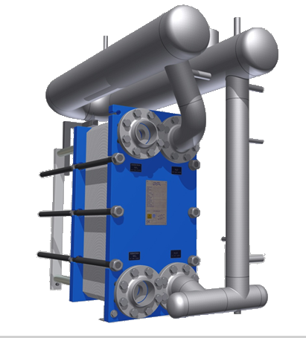
U-Turn separator design
Liquid injection with “ejector function” to reduce wet return dP
Small diameter surge drum
Self-supporting construction
Wet Return – Low Pressure Drop
Advantages:
High separation efficiency
Low weight
Compact
Energy efficient
Disadvantages:
Very small volume for liquid hold up
Drop leg:
Integrated piping for liquid level sensors and high level shut-off devices
Standard oil-pot included
Backflow preventer +
Drip nose to prevent oil to enter.
Notes:
U Turn concept- the name comes from the u- bend as shown on the picture, made from stainless steel pipes welded together, leak and pressure tested to the design requirements along with design verification. Low wet return pressure drop is built into the system design. Drop leg use for level control and operation with standard control option. Standard oil pot included with design

Slide 8
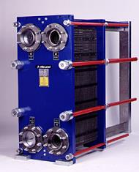
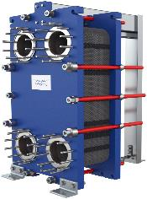
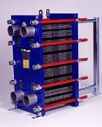
U-turn and Heat Exchangers
for Flooded Evaporation
Semi-Welded PHE

Slide 9
How to select
You need to know both the condensing temperature and the evaporation temperature to be able to select the correct U-turn.
The capacity will tell you which U-turn to choose and then the U-turn will tell you what length on the carrying bar you need, never the opposite.
If the U-turn is longer you need to select a longer carrying bar but if the U-turn is shorter you have to choose a longer U-turn and keep the carrying bar.

Slide 10
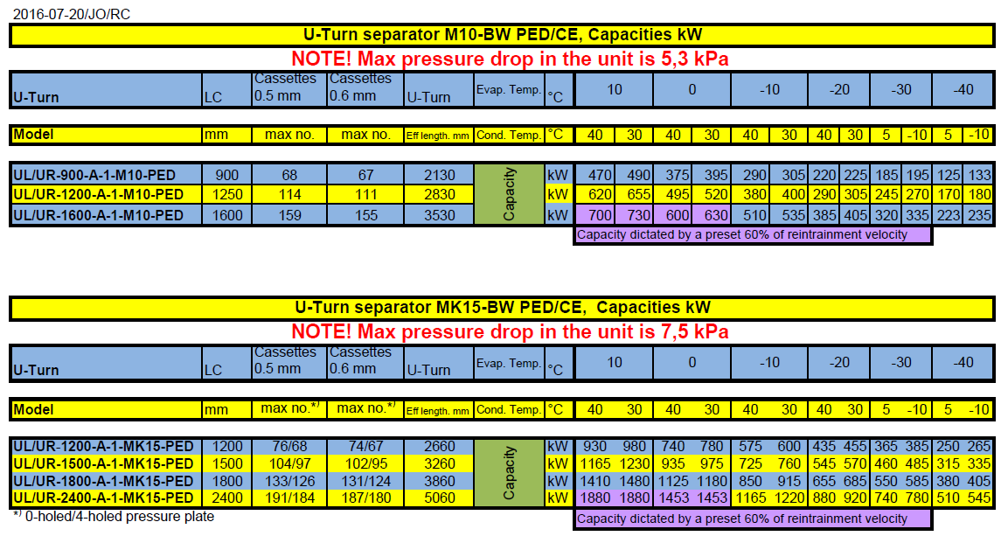
How to select?

Slide 11
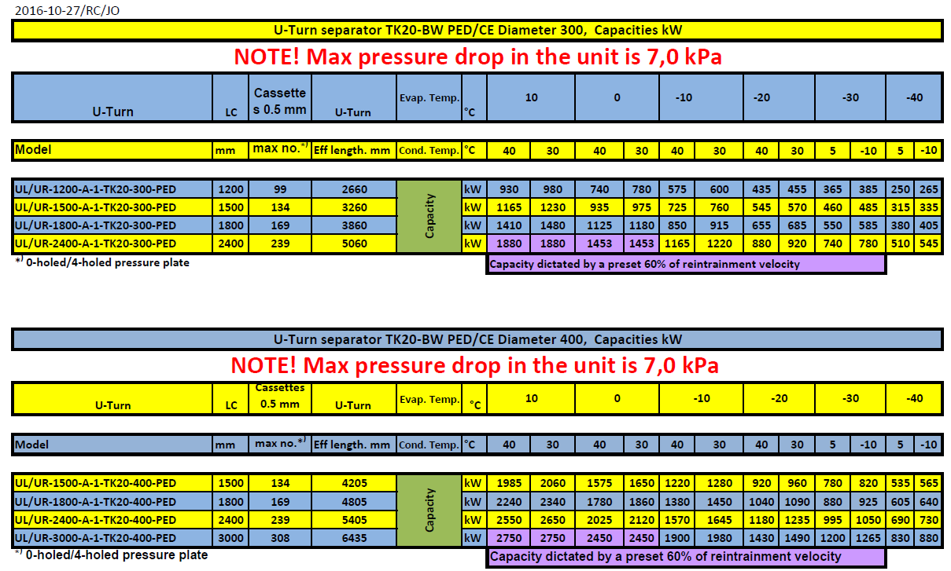
How to select?

Slide 12

The flooded evaporator Thermosyphon system
1. ΔPfriction
2. ΔPstatic
3. ΔPcomponents
4. Expansion & contraction
5. ΔPPHE
4
3
1
2
4
Driving head
=∑ΔP
3
1
5
3
Notes:
Traditional components of a thermosiphon system- The gravity separator the heat exchanger and the interconnecting piping which completes the system. The word thermosiphon mean natural circulation due to density difference in the liquid head and the heat exchanger + wet return line, Normally the liquid head is the driving force for the whole process.
(We will discuss the pressure drop equation which is the basic principle behind the whole process further down the presentation)

Slide 13


Max. available pressure drop Thermosiphon Ref side
$$∆p=ρ.g.h= ρ.g.(h_{hx}+ h_{wrl})$$
$$h_{wrl} ≈0.5m$$
$$h_{hx}={CC}_{vertical}$$
Notes:
The overall equation for a themosiphon system is highlighted here. The static head equals the pressure drop through the HEX and Wet return line . So high static head equates to high wet return line pressure drop which in turn leads to lesser efficiency as described in the following slides. This is because if the HEX pressure drop is contsant, the higher liquid head will contribute to wet return line pressure drop

Slide 14
Change in temperature per meter Liquid Column pressure drop
Notes:
High wet return line pressure drop relates to high evaporation temperature in the evaporator to compensate for the pressure drop from the evaporator outlet to the separator resulting in close temp approach and if not compenstated with larger surface area will contribute to higher energy costs . This will also relate to higher charge and bigger heat exchangers due to the requirements.

Slide 15
Change in efficiency (COP) per meter Liquid Column pressure drop
Tc=35°C, ηis=0,75
Notes:
As this slide shows followinig from the previous slide a 1 meter wet return line pressure drop decreases the COP by approx 2.75% in this simulation. So higher than normal wet return line pressure drop will cause a drop in energy efficiency

Slide 16
Energy consumption for a 500kW (142TR) single stage system operating in Copenhagen
Trad. 1428 MWh
U-turn1387 MWh
ΔQel = 41 MWh
or…
~4000 €/year
Notes:
This shows an energy simulation for all year around operation in Copenhagen and the difference between the higher wet return pressure drop with the traditional separator and the U-Turn results in higher energy costs to the tune of 4000 Euros approx per year

Slide 17
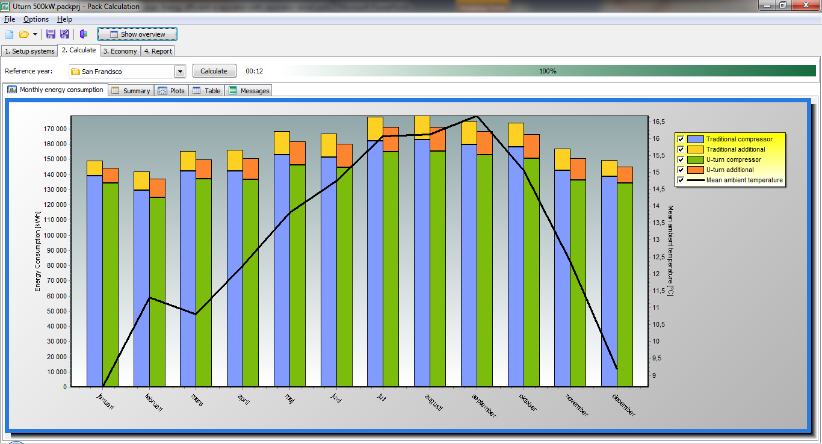
Energy consumption for a 500kW (142TR) single stage system operating in SanFransisco
Trad. 1949 MWh
U-turn1876 MWh
ΔQel = 73 MWh
or…
~$10000 /year
Notes:
This shows an energy simulation for all year around operation in Copenhagen and the difference between the higher wet return pressure drop with the traditional separator and the U-Turn results in higher energy costs to the tune of 4000 Euros approx per year

Slide 18
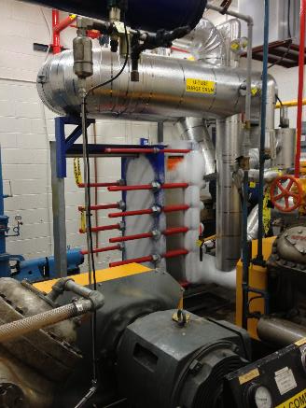
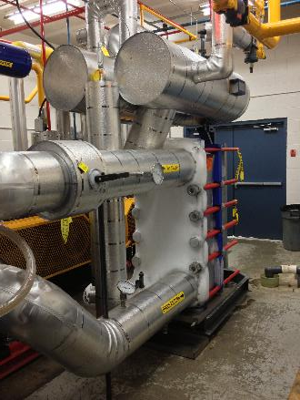
British Columbia installations in Richmond, Nanaimo, Comox & Fort. St. John

Slide 19
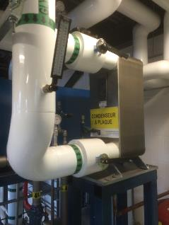
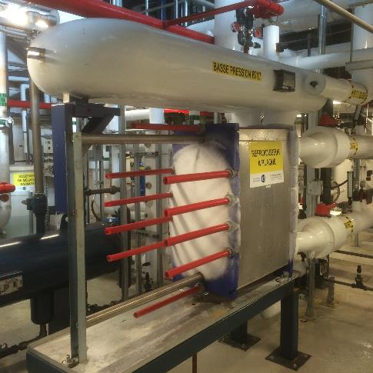
Ice Rink in Montreal City
AlfaNova plate condenser
U-turn evaporator 71 TR
Charge :168 lbs, or
2,4 lbs/TR

Slide 20
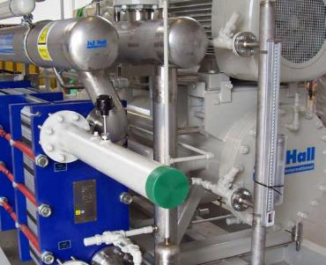
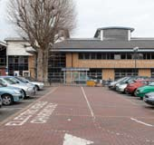
Homerton University Hospital
Existing R22 System was upgraded from 340 to 500 kW
(97 to 142 TR)
Charge dropped from 250 kg (550 lbs) of R22 in the old system to 50 kg (110 lbs) of NH3 in the new system
Result – Increase in capacity by 50%, charge reduced from
0.74 to 0.1 kg/kW ( 5.7 to 0.77 lbs/TR)
Notes:
This is a very good example where the concept has been used in a normal air conditioning chiller application for a UK hospital application. As you can see a 500 Kw system was installed replacing the 340 Kw R22 system. With NH3 this was achieved with nearly 1/5th the charge.

Slide 21
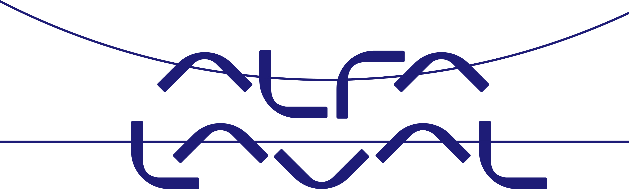
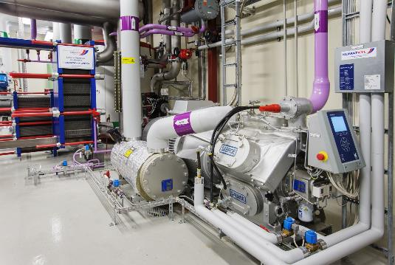
Ammonia Heat Pump at Alfa Laval manufacturing site in Lund, Sweden
M10BW-FT condenser
Evaporator MK15 with U-turn
Cooling capacity 707kW/202 TR
Heating capacity: 827kW/236TR
Charge : 40 kg / 88 lbs, or
0.048 kg/kW / 0.37 lbs/TR
Environment: Reducing the CO₂ emission with 140 MT / year Energy cost: reduced with >160 kEUR / year

Slide 22
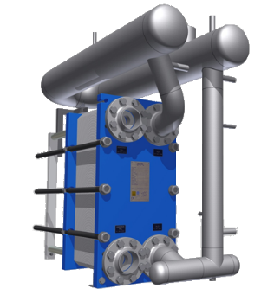
Conclusion
Combination of different separation techniques make the U-Turn compact, low charge and efficient liquid separator
Premounted, approved …Easy to install
Low Charge
Low pressure drop in wet return line ensures high energy efficiency
Small footprint - easy access to plant room
Notes:
The conclusion above clearly shows that the U-Turn design gives us the most optimum separation incorporating low charge and efficient separation. The concept shows how by applying the basics of heat transfer, separation and fluid mechanics which is the forte of Alfa Laval an innovative separator module for use with heat exchangers was invented.

Slide 24
Thank you for your attention !

